Slide 1
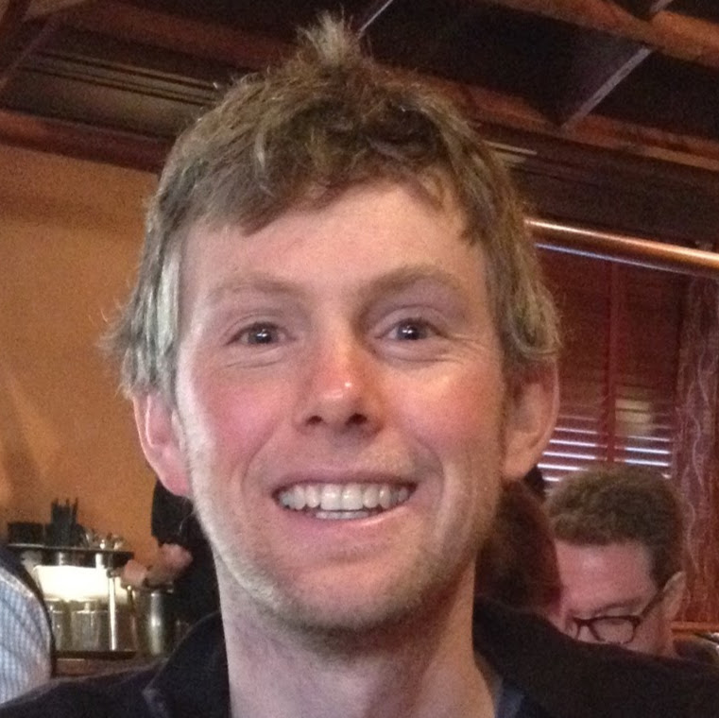

The Hamlyn Centre Winter School 2018
GROUP 2

Slide 2
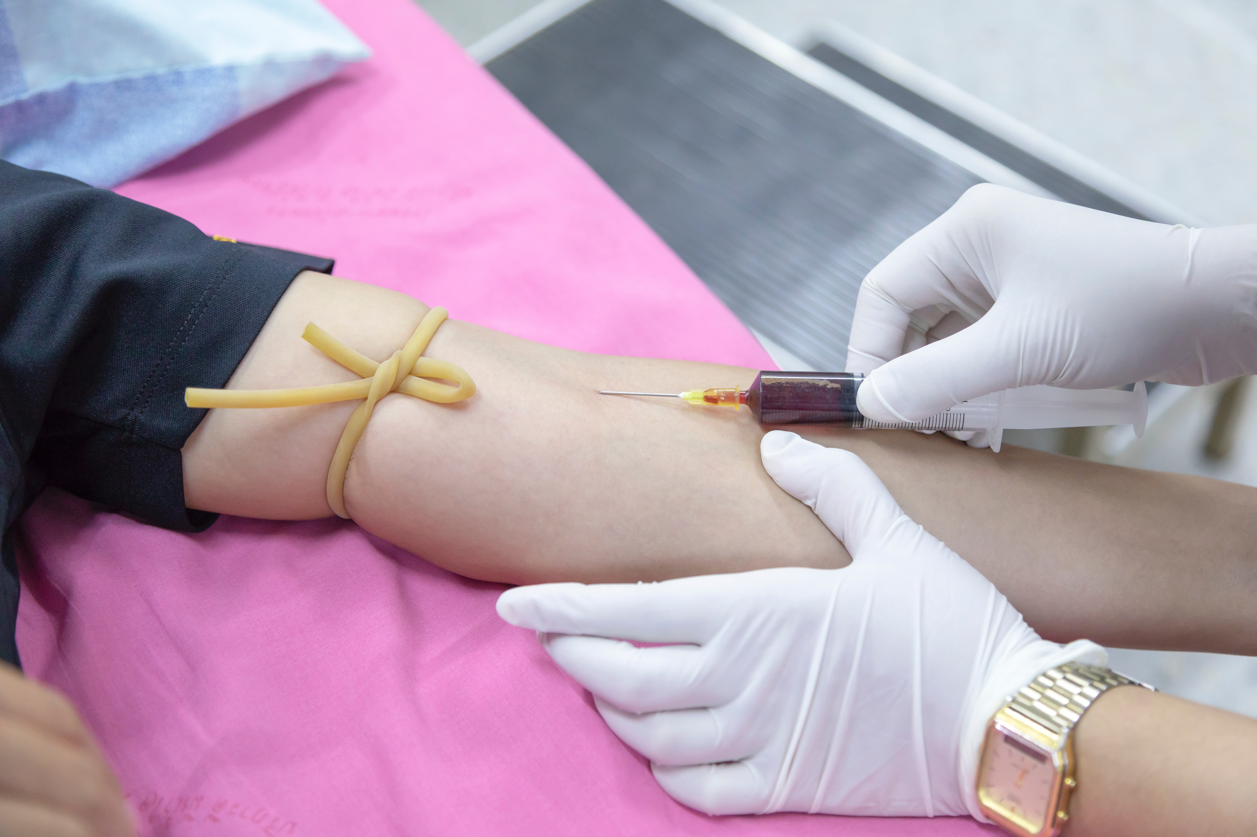
Retrieved from www.pexels.com under their free licensing policy. Author – Amornthep Srina
Notes:
Funny story about missed veins

Slide 3
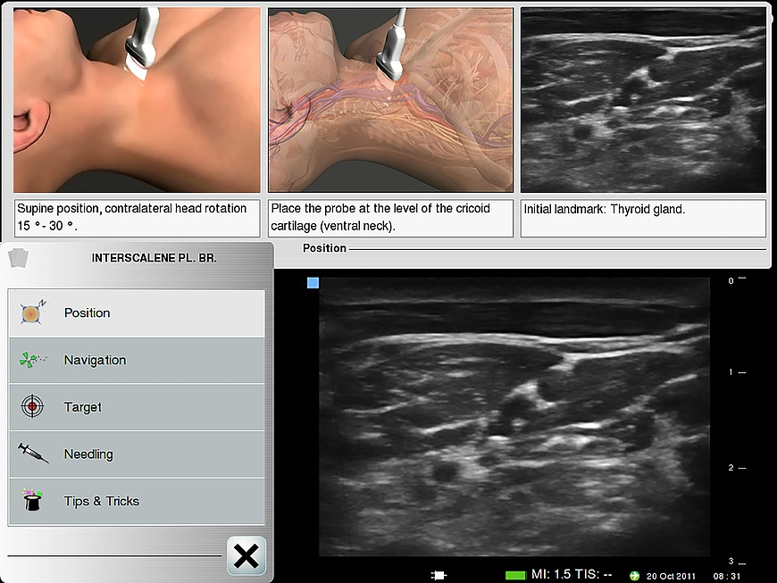
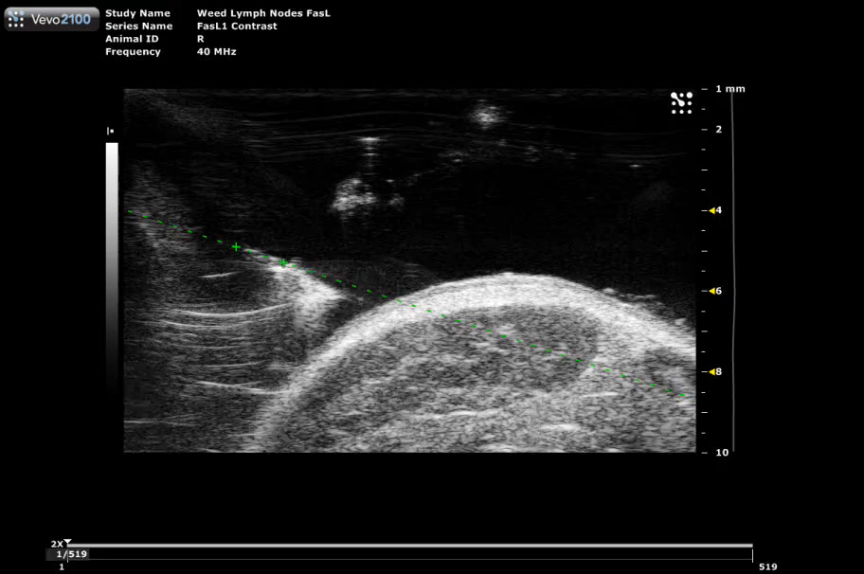
Retrieved from Wikimedia Commons under GNU licence. Author – MrArifnajafov
Notes:
Important practical applications of ultrasound that could be more serious than drawing blood
Central venous injection
Parathyroid Injection

Slide 4
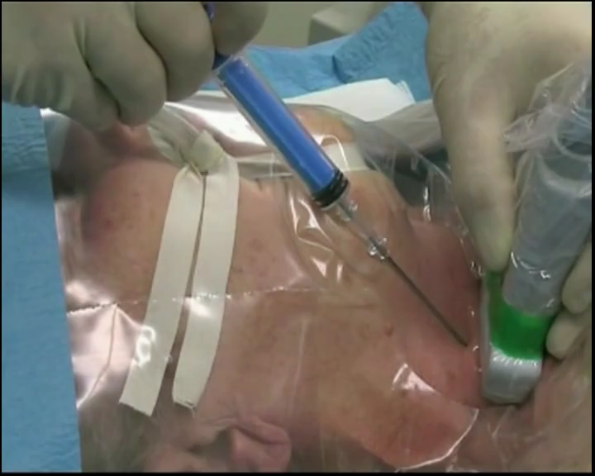
Retrieved from Wikimedia Commons under GNU licence. Author – MrArifnajafov
Notes:
This is why we chose Ultrasound – To improve guidance – Show murky image of ultrasound – Important structures

Slide 5
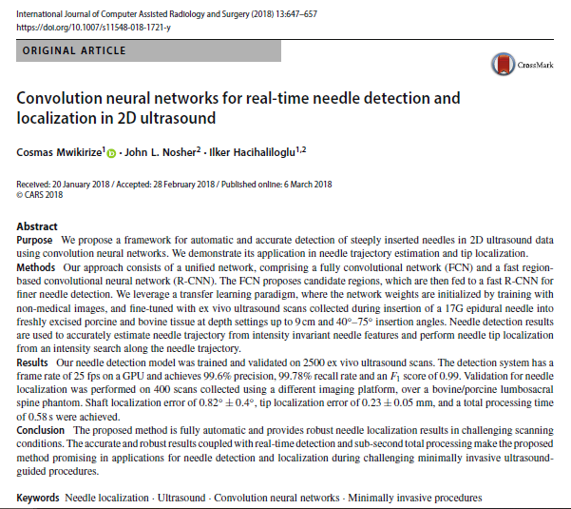
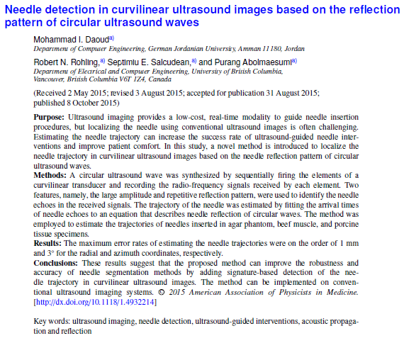
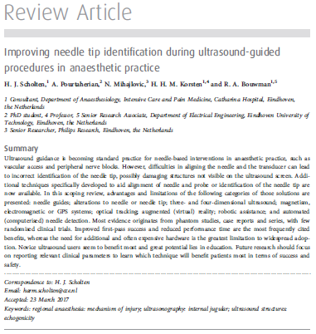
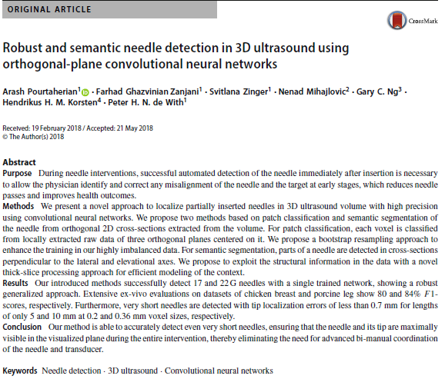
Notes:
Not just a hunch. We know that research interest exists as is evident from the following papers:
Paper 1
Paper 2
Interesting result 3 etc. etc.

Slide 6
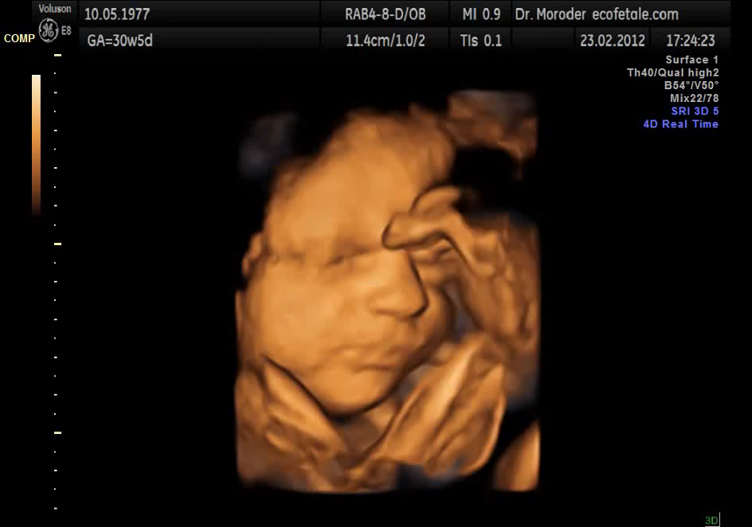
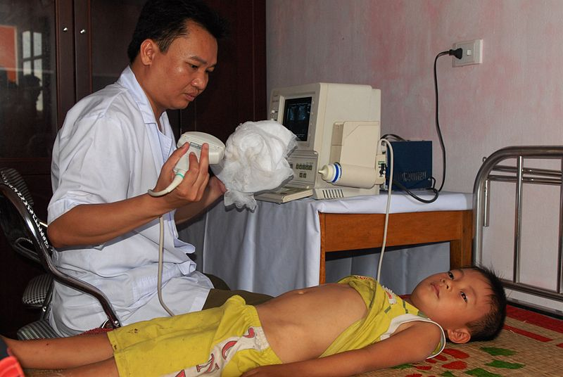
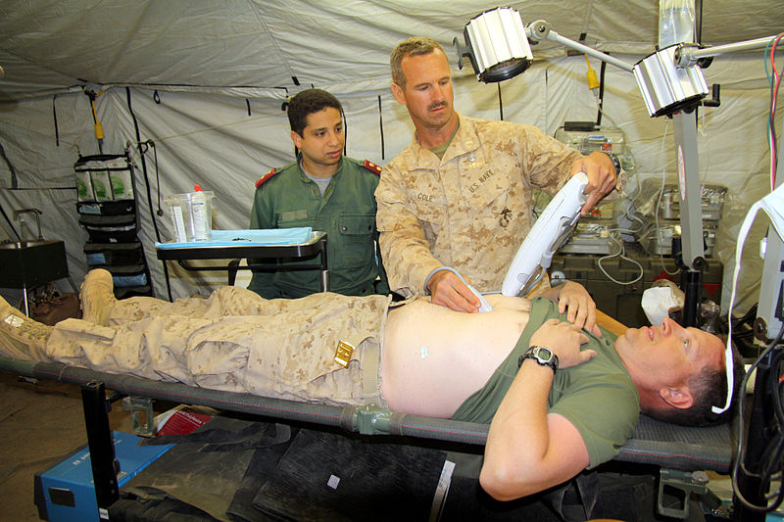
Retrieved from Wikimedia Commons under CCA-S 3.0 licence. Author – Moroder. USMC public domain.
Notes:
What are the main benefits of Ultrasound?
- Fast, inexpensive, universal, can be used for pre-natal scanning

Slide 7
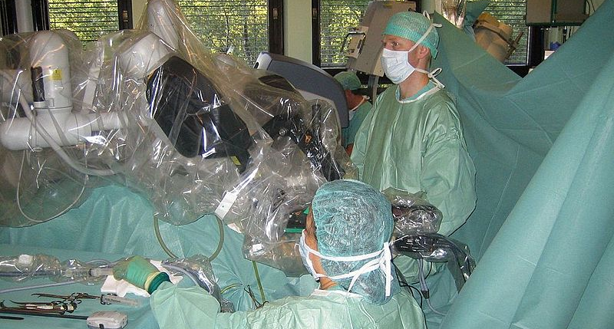
Retrieved from Wikimedia Commons under CCA-SA 4.0 licence. Author – Keeve
Notes:
But why US? Tracking is better with a sensor no?
Not if you want to keep the surgical workflow the same. Perceptual docking

Slide 8
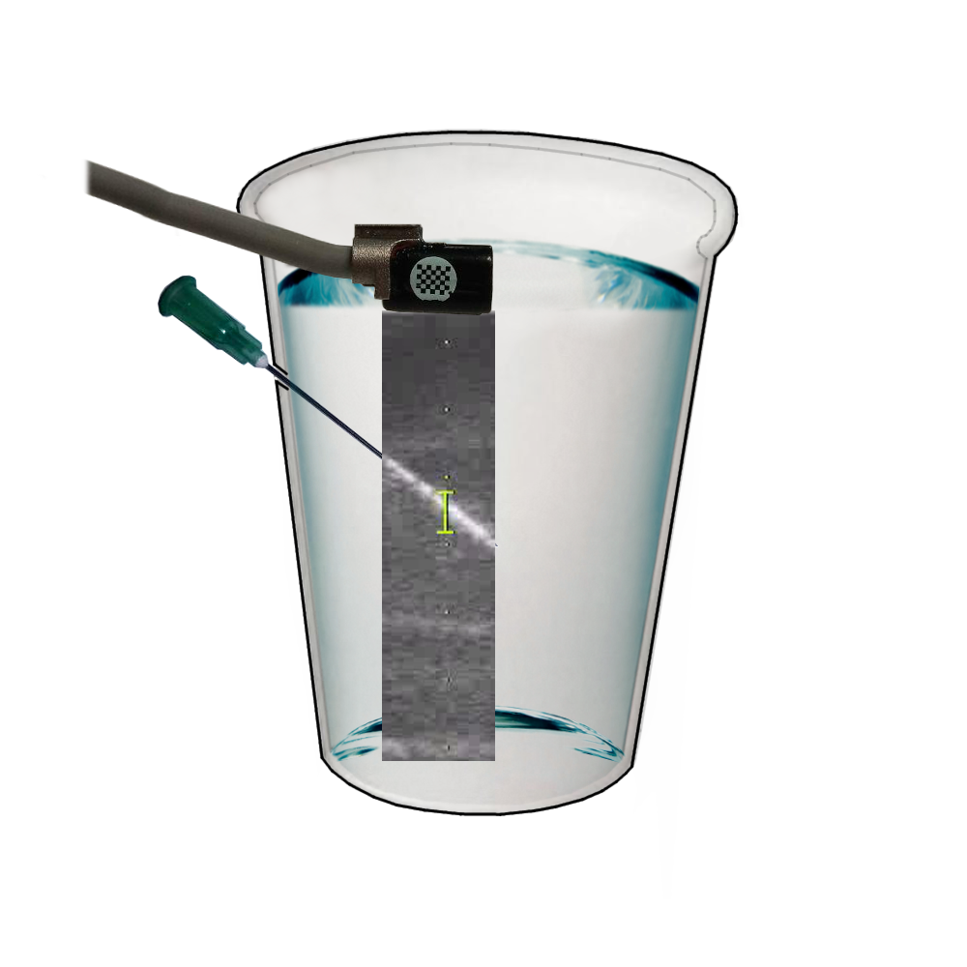
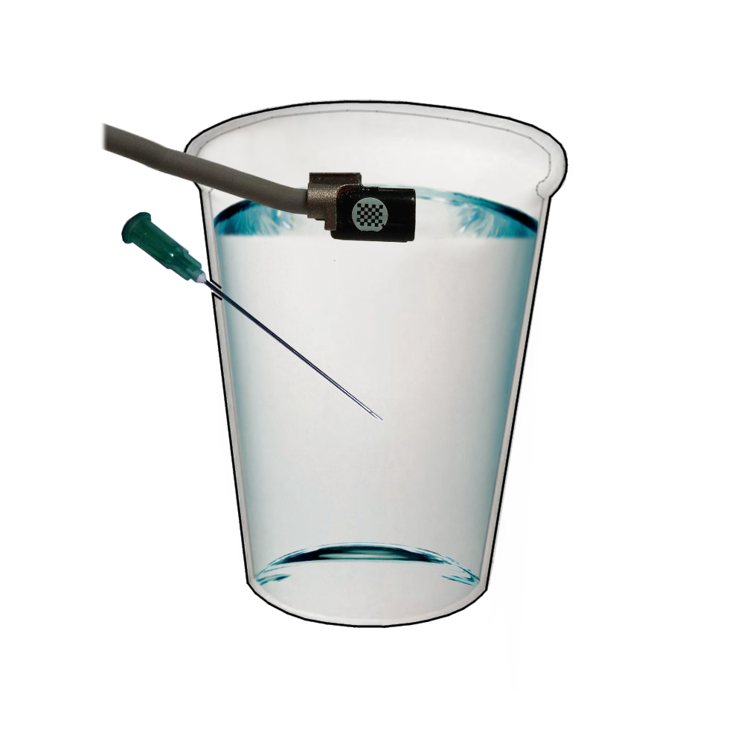
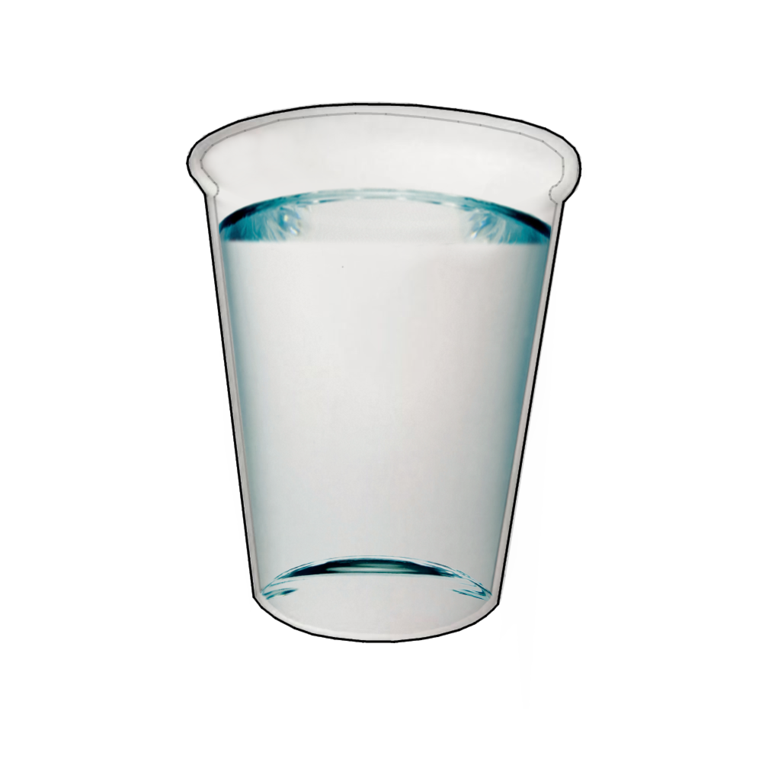

Slide 9
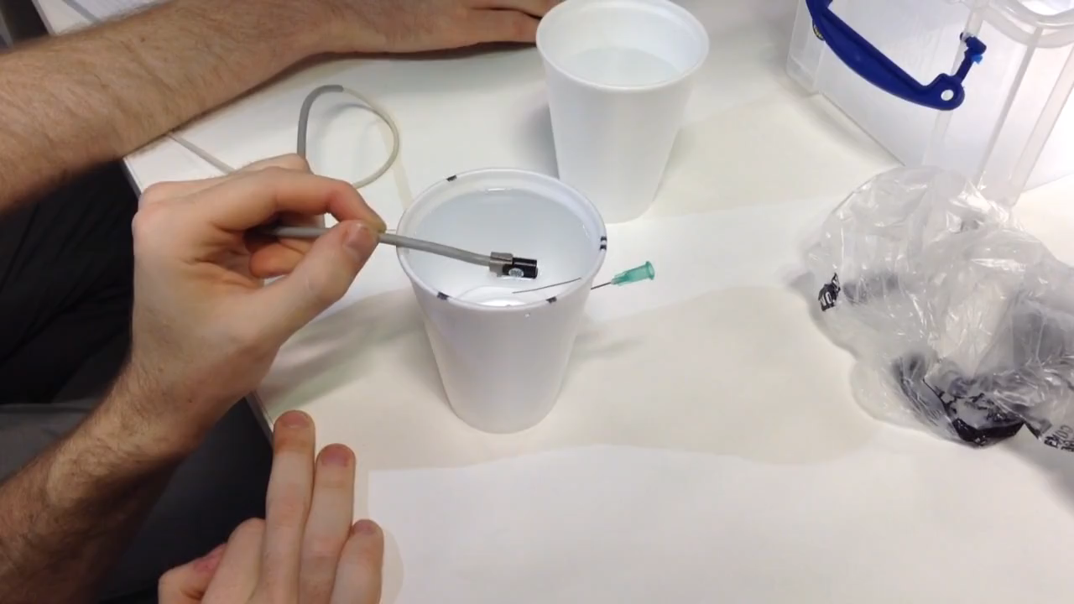
Equipment used courtesy of the Hamlyn Centre at Imperial College London, St. Mary’s campus
Notes:
We need some data, of course. This is how we collected it.
- Show video of data collection (muted) or pictures of testing with US

Slide 10
4,681 Ultrasound Images
60% Train
25% Validate
15% Test
Notes:
How did we partition the data? Nice diagram here.
Need training and testing data 70/30

Slide 11




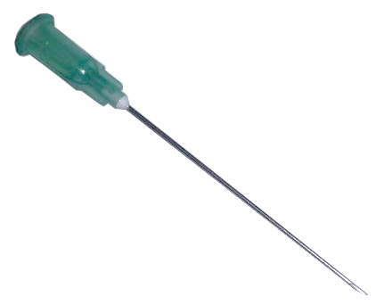
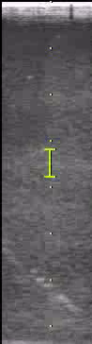
Global Max Pooling
512
256
Softmax
128
Input
1
96
https://upload.wikimedia.org/wikipedia/commons/thumb/1/11/TensorFlowLogo.svg/522px-TensorFlowLogo.svg.png
https://keras.io/
https://upload.wikimedia.org/wikipedia/commons/1/1a/NumPy_logo.svg
https://blog.thedataincubator.com/wp-content/uploads/2017/01/jupyter-logo-300x298.png
Notes:
What did we do with the data?
Placed it in a CNN. WHY?
Because we want this solution to be practical, valuable. CNN can be trained, and can identify new test data cases.
What does our CNN look like?
Flow diagram of the CNN. Explain what is it in greater detail and reiterate importance

Slide 12
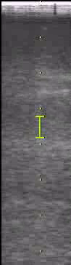
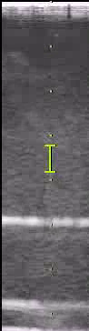
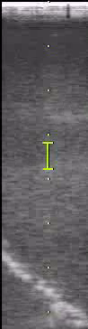
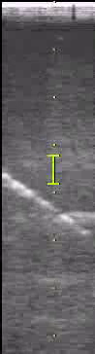
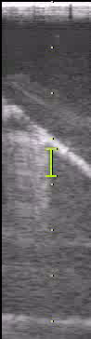
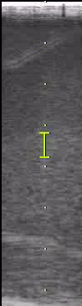
{ 0 , 1 }
✓
Notes:
What did we do with the data?
Placed it in a CNN. WHY?
Because we want this solution to be practical, valuable. CNN can be trained, and can identify new test data cases.
What does our CNN look like?
Flow diagram of the CNN. Explain what is it in greater detail and reiterate importance

Slide 13
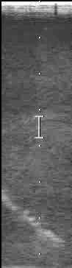
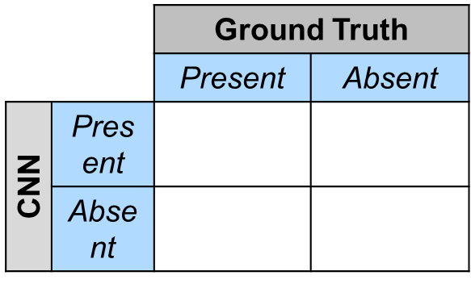
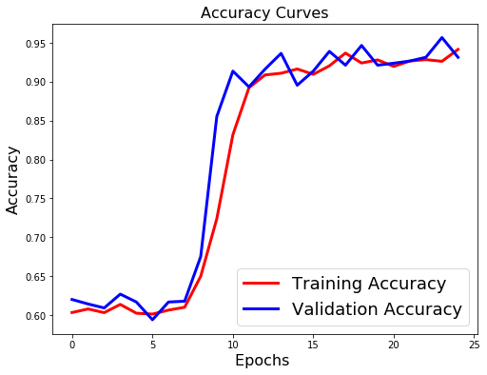
93.8%
Notes:
These are the results.
94% accuracy with the annotated testing data in water.
Really clean image, so not practical. How about a phantom?

Slide 14
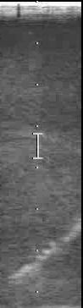
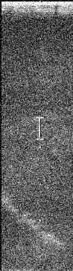
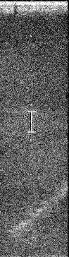

18,776 Ultrasound Images
60% Train
25% Valid.
15%
93.8%
Notes:
Created a new data set with speckling and noise.
How did it perform?
One step further, let’s use a real phantom?

Slide 15
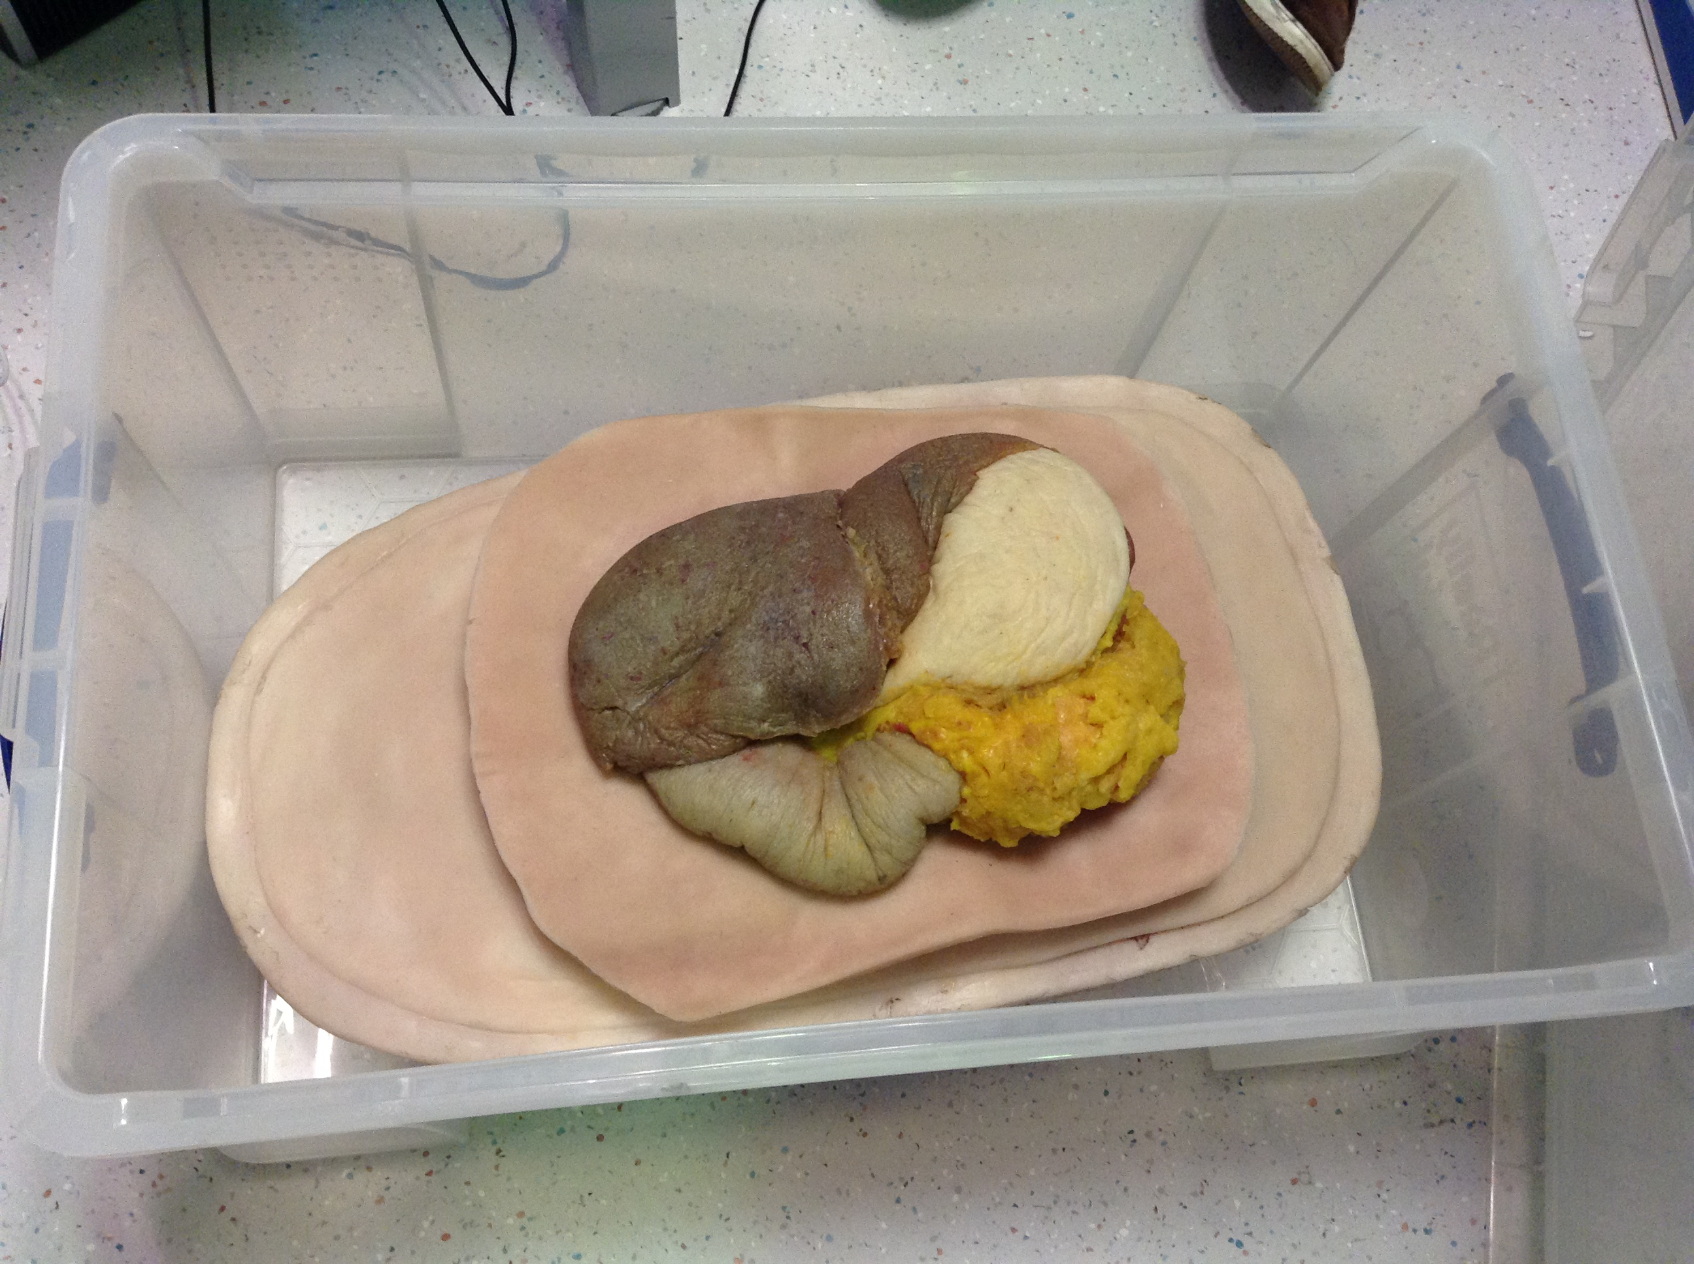
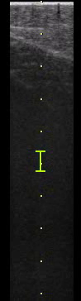
Picture of Ultrasound of the Phantom
Notes:
Used the trained data to identify the needle in a phantom. How did it do?
Here are some pictures of our phantom and the results
Used a phantom silicon model. Placed a needle in the model and performed the same type of scan.
Results?

Slide 16
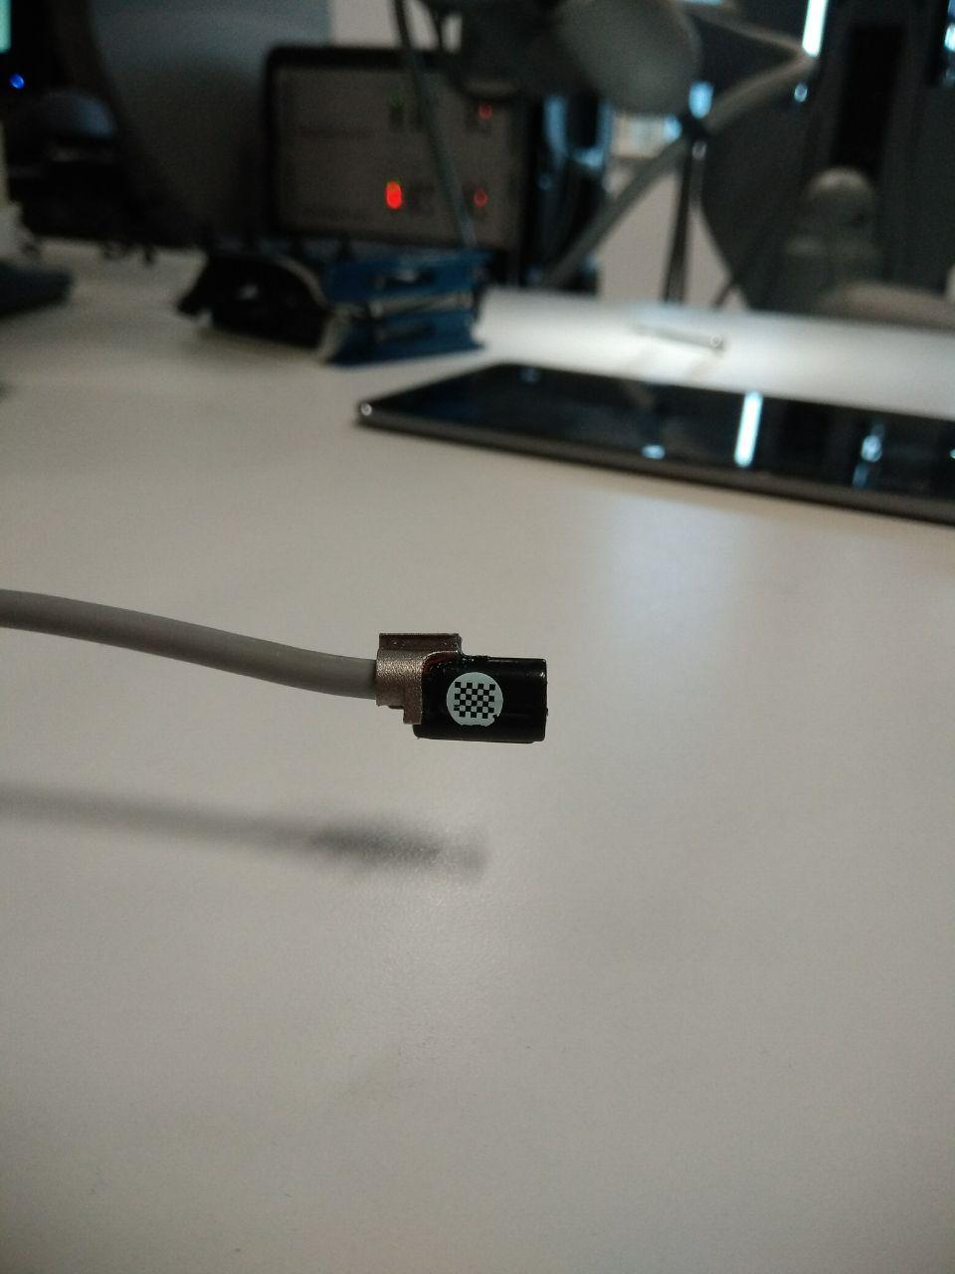
Notes:
How can we make this project better?
Larger dataset
Larger ultrasound probe
Augmenting our training technique (as shown in this paper)
Real-time image processing.

Slide 17
So just to summarise:
Needle detection and guidance is useful, but conventionally has issues that can be approved on with engineering.
We propose automated needle detecting using a CNN.
These are our results. This is where we can improve.

Slide 18
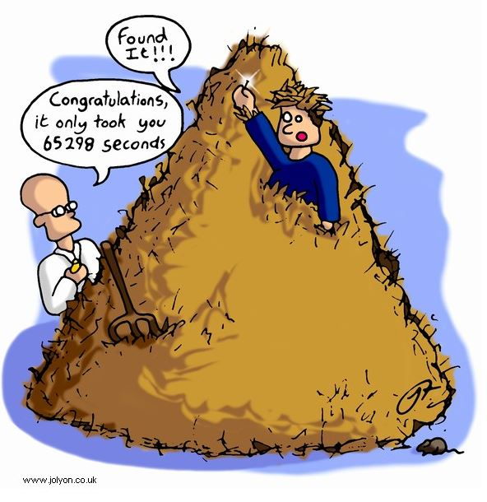
http://www.automatedbuildings.com/news/mar16/reviews/1602180356haystack.html

